Slide 1
Game-Based Learning
Good Learning via Gaming...
Kath Pettit
OLTD 508
September 2018

Slide 2
Why Do Games Help Students Learn?
James Paul Gee argues that the same elements that make good video games appealing to students as entertainment can also encourage deep and meaningful learning within our education system. He describes 13 principles of learning that such games use to engage people in learning.
Agent Principle
Customization Principle
Identity Principle
Manipulation
These principles empower learners.
Well-ordered problems
Pleasantly frustrating problems
Cycle of Expertise
Information - just in time and on demand
Fish Tank Principle
Sandbox Principle
Skills and Strategies
These principles focus on Problem Based Learning.
System Thinking
Model Based Reasoning
Situated Meaning
These principles develop deep understanding.

Slide 3
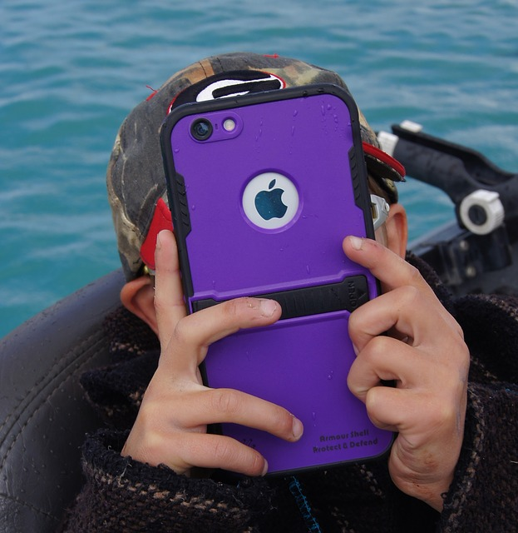
Three Principles That Relate to my Teaching Experience
While I can see that all of Gee’s principles contribute to making games powerful tools for learning, I have chosen four that I feel are particularly important to my teaching situation which is kindergarten. Two of these principles (Well-ordered Problems and Pleasantly Frustrating Problems) seem to be very closely related at the early primary level.
Customization Principle
Well-ordered Problems
Pleasantly Frustrated
Sandbox Principle

Slide 4
Customization Principle
The Customization Principle refers to the fact that learners do not all learn the same way and that material presented in a variety of ways or having a variety of options for completion of a task, is an important advantage of good games. Allowing learners to choose which options appeal to them empowers the learner to take control of their learning.
This principle drew my attention to the new BC Curriculum where teachers are encouraged to use a variety of ways to present content, increase knowledge and show learning. For example, the Big Idea relating to ‘Patterning’ can be presented and practiced through movement, sound, manipulatives as well as the traditional paper and pencil activities. This range of activities allows different kinds of learners to attempt a variety of modes to increase their understanding of a concept. It also allows them to focus on the methods that appeal to them most.

Slide 5
2. Well Ordered Problems
This principle ensures that when a learner starts on a problem-solving journey, they begin with problems that are easy to solve and then increase the difficulty as the journey continues. This is a fundamental element of games and a big part of the ‘hook’ that encourages the player to continue playing.
This sequencing of problems appealed to me as a kindergarten teacher, especially at the beginning of the school year. Students experiencing success are far more likely to continue along a path of learning. Being faced with tasks that are too hard creates frustration. One of the most challenging aspects of teaching in kindergarten is breaking a task down into small enough steps so that those with little or no familiarity can be successful.

Slide 6
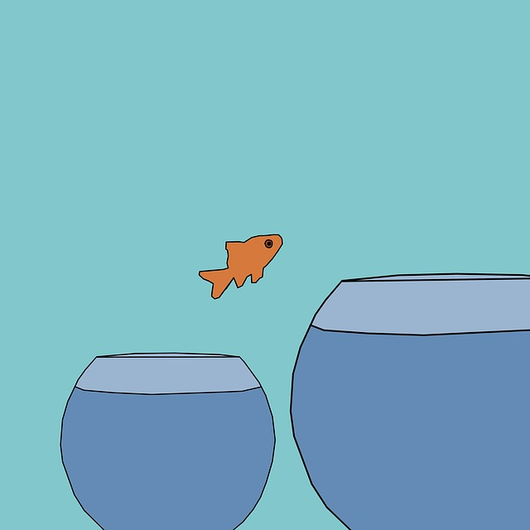
3. Pleasantly Frustrating Problems
In my mind, the principle of presenting problems in a pleasantly frustrating way, is closely related to the principle of well-ordered problems. Problems that can be solved without over-taxing the learner and have an element of enjoyment, can be dealt with in a satisfying way. Good games have a motivational component and do not put too much stress on the student, before solutions are found and success is experienced.
Challenges that are not overwhelming are key to progress with young children. Many of my new students struggle to print letters on paper. However, the ‘Letter School’ app allows them to use their finger to trace letters on a touchscreen while animation brings the letter to life. The students were being asked to practice very similar movements as they would with pencils but the challenge of accurately creating letters became ‘pleasantly frustrating’ without the need for tools such as pencils. There was just enough challenge to allow us to work right up till the bell rang! (That rarely happens at this time of the year!)

Slide 7
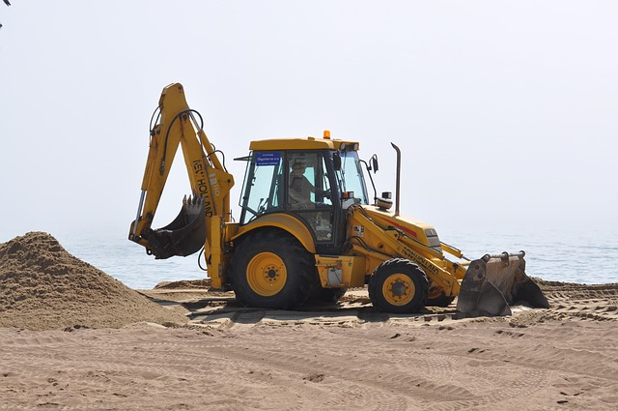
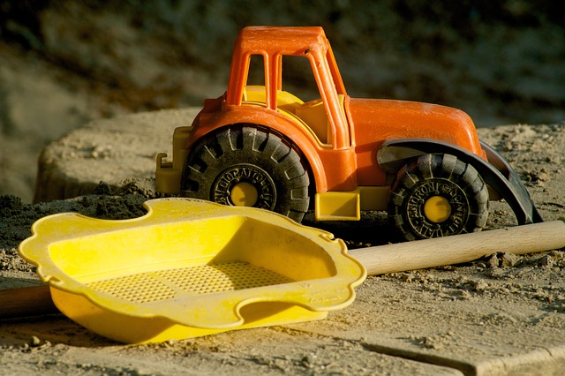
4. Sandbox Principle
The concept behind the Sandbox Principle is that learners need a safe place to try out new things that may appear daunting at first. Good games allow this to happen making is possible for learners to accept risks with less of the fear associated with enormous challenges.
This principle spoke to me as a teacher of very young children as often there is a fear of being ‘wrong’ or a fear of failure, when faced with a new situation or challenge. It made me think of why we use markers on a whiteboard instead of with paper, when learning to print or draw. This is so that mistakes or ‘trial runs’ can be erased quickly and easily, thus reducing the anxiety associated with the more permanent reminders on paper.

Slide 8
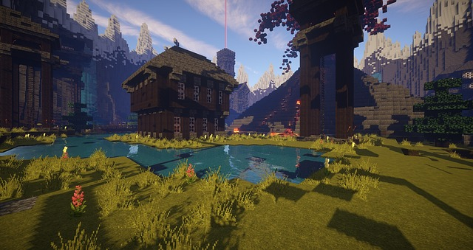
Definitions of Terms in Mobile Technologies
The following definitions each have an important part to play in the understanding of mobile technologies in education. I will attempt to describe each in detail and hope to highlight their differences.
Gamification
Game-Based Learning
Serious Games
Simulations
Commercial Off-The Shelf Games (COTS)

Slide 9
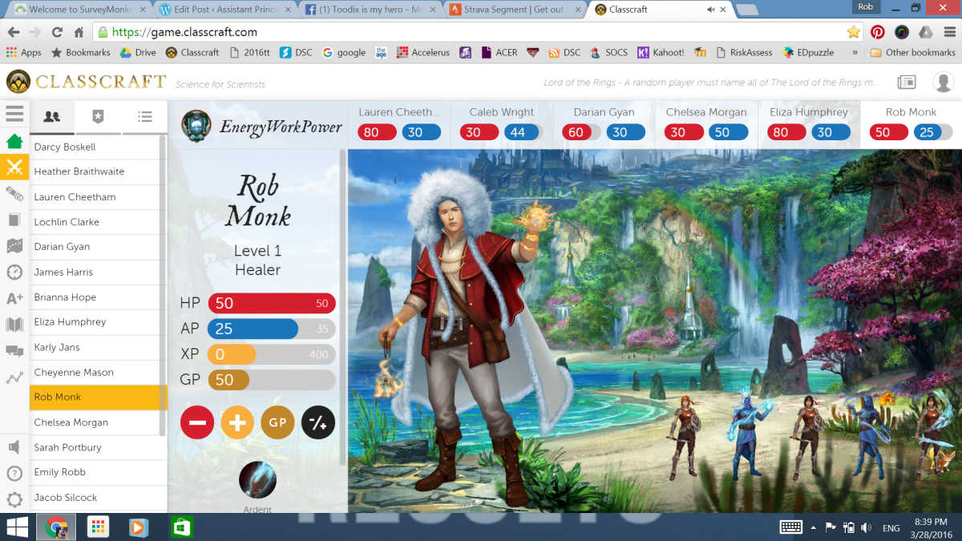
Gamification -Definition
According to Claudia Pesce, Gamification is defined as ‘the use of game elements and game design techniques in a non-game context’, for example in a classroom. It is the process of integrating these aspects of a game into an existing program in order to increase motivation and engagement.
Game elements may include:
Leaderboards
Avatars
Points
Levels
Rewards
Badges
Game design techniques involve
the creation of a game that is designed to motivate and engage students to achieve a defined goal. Is is not simply playing a game in class.

Slide 10
Use of Gamification in Kindergarten
I have used Kahoot! in my kindergarten class several times. It is a simple form of gamification. The short games work well with the age group and the enthusiasm and engagement is actually sometimes a little overwhelming! For example, as a follow up activity to a unit about Canadian coins, I created a Kahoot! to check for understanding. Despite this being the first time such a game was introduced in class, the students very quickly caught on to the logistics of the game and signed in. They eagerly looked for their names on the big screen and were certainly paying close attention to the questions and how to answer them. Obviously, because of the young age, some explanation was necessary when students got the correct answer but their name did not appear on the leaderboard. While the outcome of the Kahoot! may provide an opportunity for some formative assessment, due to the fun-like atmosphere, I am not convinced this would be entirely accurate.

Slide 11
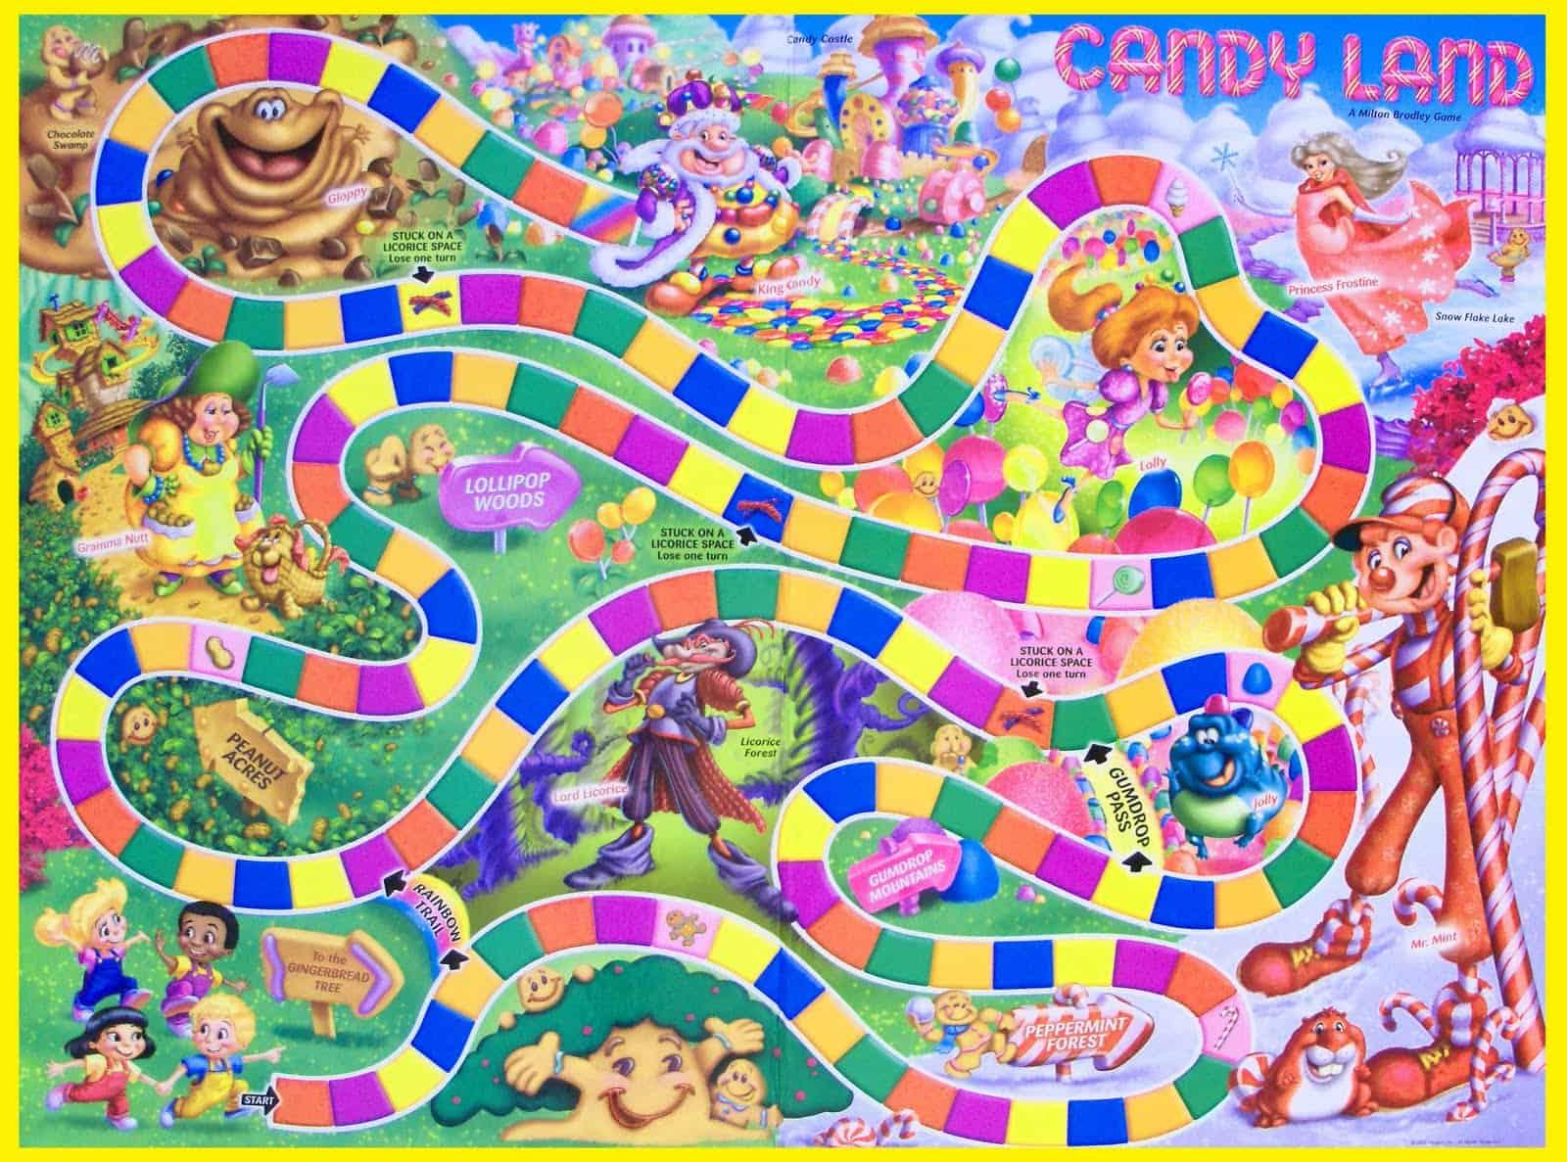
Game-Based Learning - Definition
Game-Based Learning is the use of games in the classroom to teach curriculum. It is an alternative to traditional learning which often simply required rote memorization of facts. Students can engage in game-based learning individually or as part of a group. Game-Based Learning can be digital, but it can also include other games, such as, board games like ‘Candyland’ which is used to teach colour recognition. Learning outcomes of the game would be clearly defined.

Slide 12
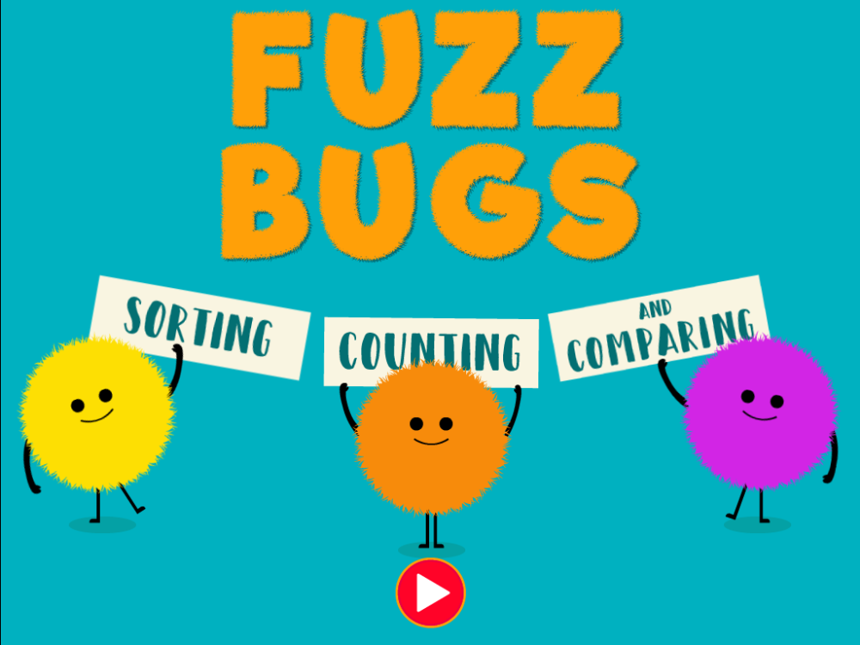
Game-Based Learning in Kindergarten
At the kindergarten level, play is paramount to engagement. Game-based learning is a huge part of the program. We play many different kinds of games, ranging from very active, such as ‘Snowball Fight’ (where students on two teams try to throw scrunched up paper in to the other team’s yard -development of the proper technique for locomotive skills) to calmer pursuits as ‘Roll the Dice’ (number recognition). The games offered in ABCYA.com focus on particular curricular areas and grade levels, giving practice in specific skills in a fun way.

Slide 13
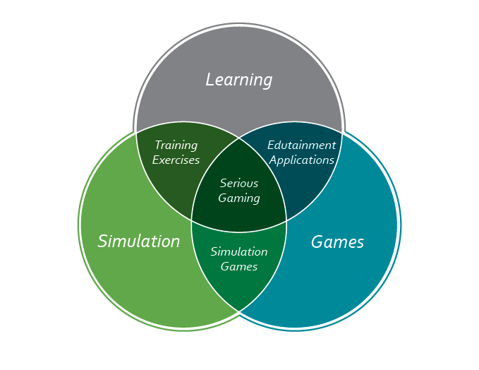
Serious Games -Definition
Although many Serious Games could also be described as ‘Simulations’, this is not true for all of them. Serious Games are usually produced for a purpose other than entertainment but include elements of fun or competition to increase the pedagogical impact of the material. Serious Games often try to change the opinions of others and reflect larger ‘real world’ problems. Another aspect of Serious Games is that they often require the user to become immersed in the game for long periods of time resulting in vivid experiences.

Slide 14
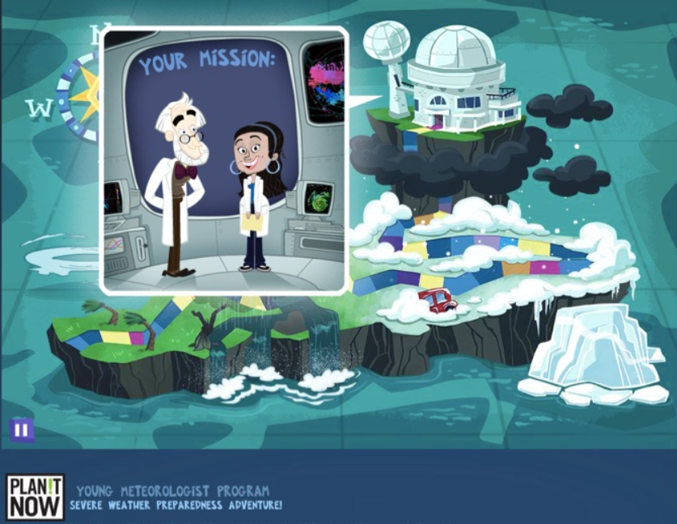
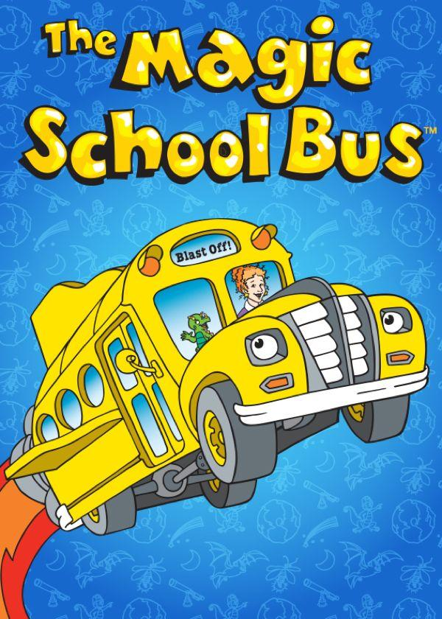
Serious Games in Kindergarten
As mentioned under ‘Game-Based Learning’ there are numerous games available to teach particular skills or content at the kindergarten level. However, I have not yet tried games that would address big ‘real world’ problems that would allow them to become immersed in the game for long periods of time. A little research has shown me that there may be some that might be suitable for young (elementary aged) children, such as those produced by environmental agencies.
My own son (aged 4 at the time) enjoyed the Magic School Bus series and spent many hours learning about such things as the Oceans and how to care for them.

Slide 15
Simulation -Definition
A Simulation is a game that attempts to copy a real life situation. It is an imitation of real life for the purpose of training, predictions or role playing. Many, but not all Simulations are Serious Games. Simulations provide a virtual experience, as in the case of a flight deck simulator, how to build a trebuchet or even surgical simulators, without the risk of actually performing the activity in reality.

Slide 16
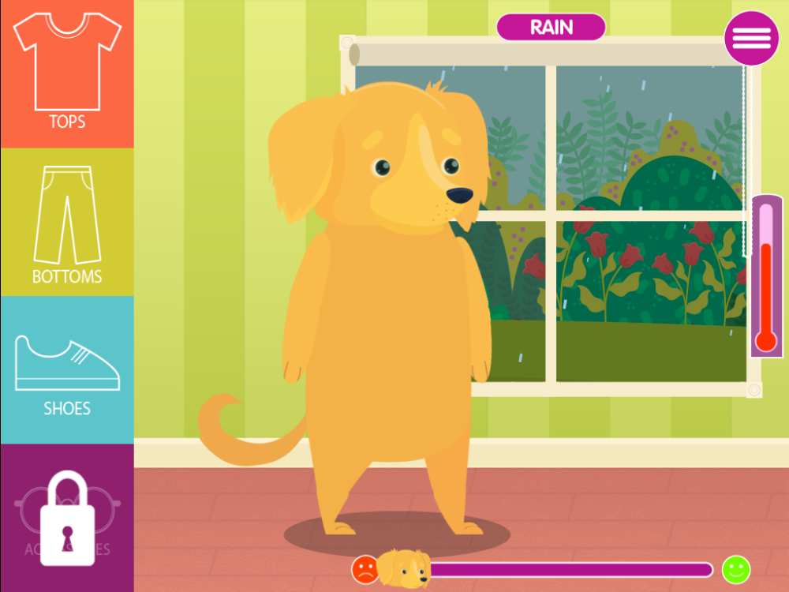
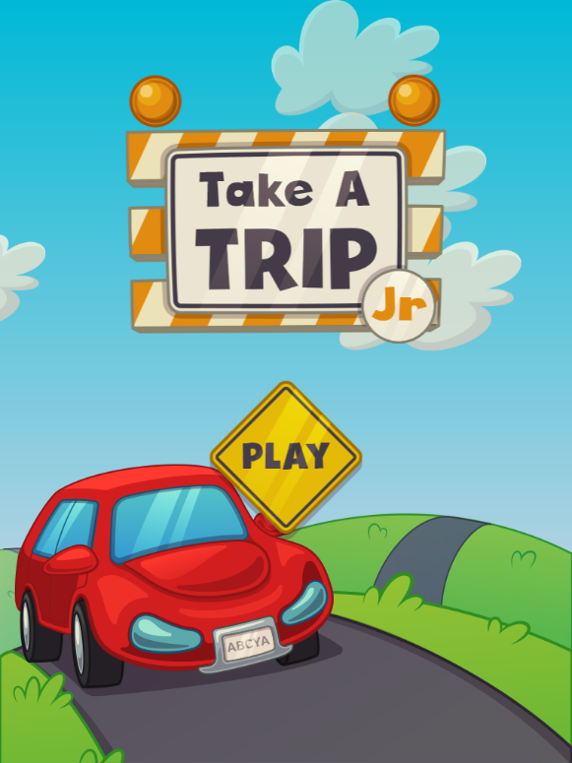
Simulation in Kindergarten
There are many Simulations available to Kindergarten age students. These of course are not nearly as complex as flight deck simulators. Students can experience cake decorating or how to successfully dress for the weather or even go for a drive around the neighbourhood!

Slide 17
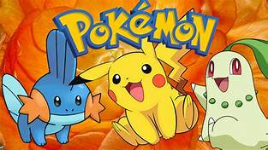
Commercial Off-The-Shelf Games (COTS)
These games are primarily produced for entertainment purposes, although some have educational value. Many have intellectual challenges and problem-solving activities. They are usually highly engaging and so make powerful tools for learning if the content is suitable.

Slide 18
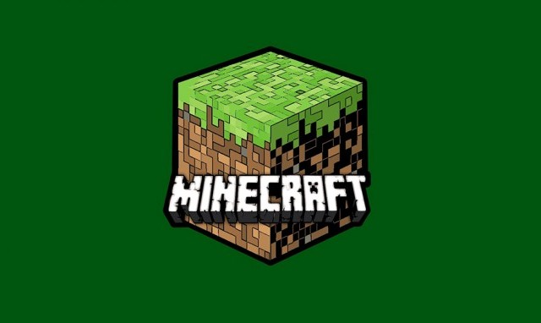
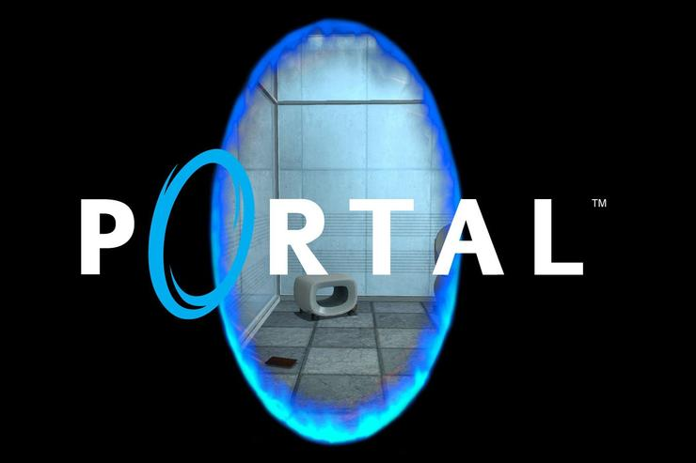
Commercial Off-The-Shelf Games in Kindergarten
I do not, at present, use COTS games in my kindergarten program. I feel at this time there is a plethora of purposely made games for education at my age level, to more than provide enough tech time for my class. It seems to me the the time required to engage with many COTS games, is in excess of what I would consider to be practical during the kindergarten day. However, older students may benefit from the 21st century skills that are incorporated in COTS games such as ‘Minecraft’ or ‘Portal’. Teachers should be very familiar with such games prior to introducing them to their students, to ensure that the content is appropriate for the educational setting.

Slide 19
Resources
Trybus, J. Game-based learning: What it is, why it works and where its going. Retrieved from: https://oltd508lewis.weebly.com/uploads/1/1/6/7/116785175/wp-trybus-game-based-learning.pdf
Serious Games or Gamification? [infographic] Retrieved from: http://playfulpandas.org/wp-content/uploads/2013/04/A3log.pdf2.gif
Pesce, C.ESL teachers ask. How can I gamify my ESL classroom? Retrieved from: https://busyteacher.org/20574-gamify-esl-classroom.html
Gee, J. Principles on gaming. Retrieved from: https://www.youtube.com/watch?v=8jdwIy7AxlU
Games V Game-Based Learning V Gamification (2015) [infographic]. Retrieved from: https://elearninginfographics.com/games-vs-game-based-learning-vs-gamification-infographic/

Slide 20
Resources cont.
What is gamification? Retrieved from: https://www.bunchball.com/gamification
What is GBL (Game-Based Learning)? EdTechReview [journal] Retrieved from: http://edtechreview.in/dictionary/298-what-is-game-based-learning?buffer_share=230ac
Wikipedia. Retrieved from: https://en.wikipedia.org/

